Slide 1
Grammar of Graphics with ggplot2
Raju Rimal

Slide 2
Outline
GRAMMAR OF GRAPHICS
COMPONENTS OF GGPLOT2
AESTHETICS MAPPING
SCALES
GEOMETRIES
FACETS
THEME

Slide 3
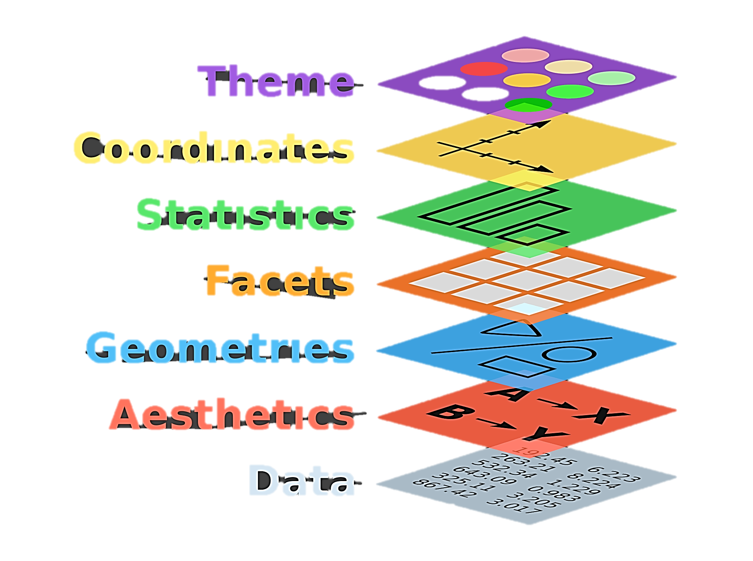
Grammar of graphics

